Slide 1
Project- 2 House Price Prediction
Linear Regression (Supervised)
Brannon Dugick
March 27 2024

Slide 2
Outline
The Use Case
About the Data
Wrangling
What we did
Results
Next Steps and Modifications
March 27 2024

Slide 3

Predict House Prices
Predict house prices based on given features while aiming to reduce prediction errors by identifying a concise set of preferred predictors.
March 27 2024

Slide 4
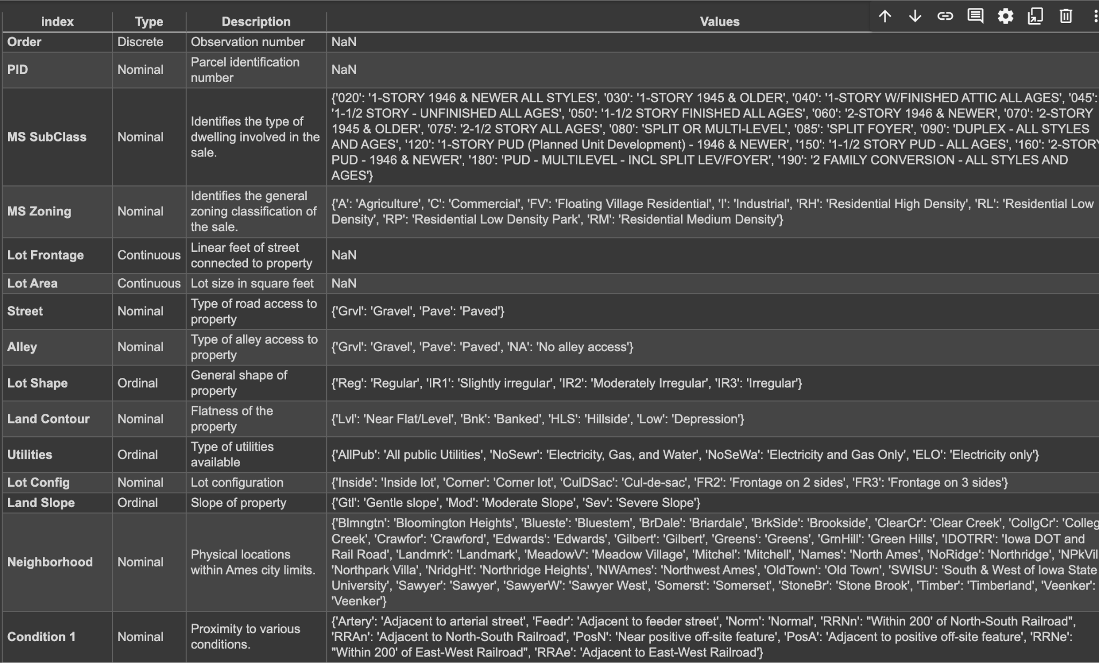
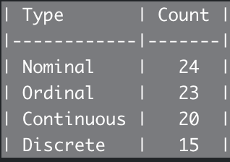
The Data
March 27 2024
Notes:
81 Features of all data types. For my initial approach, I intend to primarily concentrate on numerical data, as linear regression is particularly effective in handling this type of data.

Slide 5
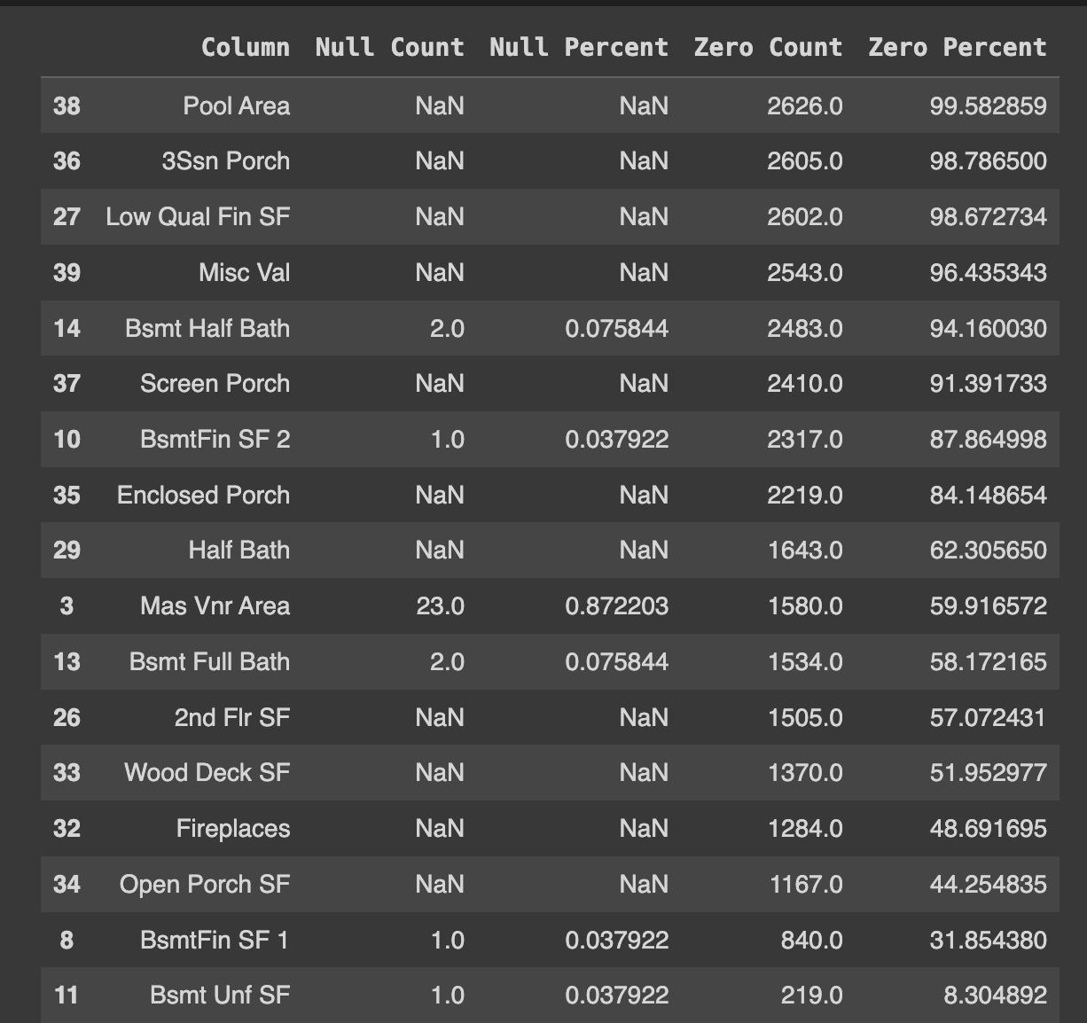
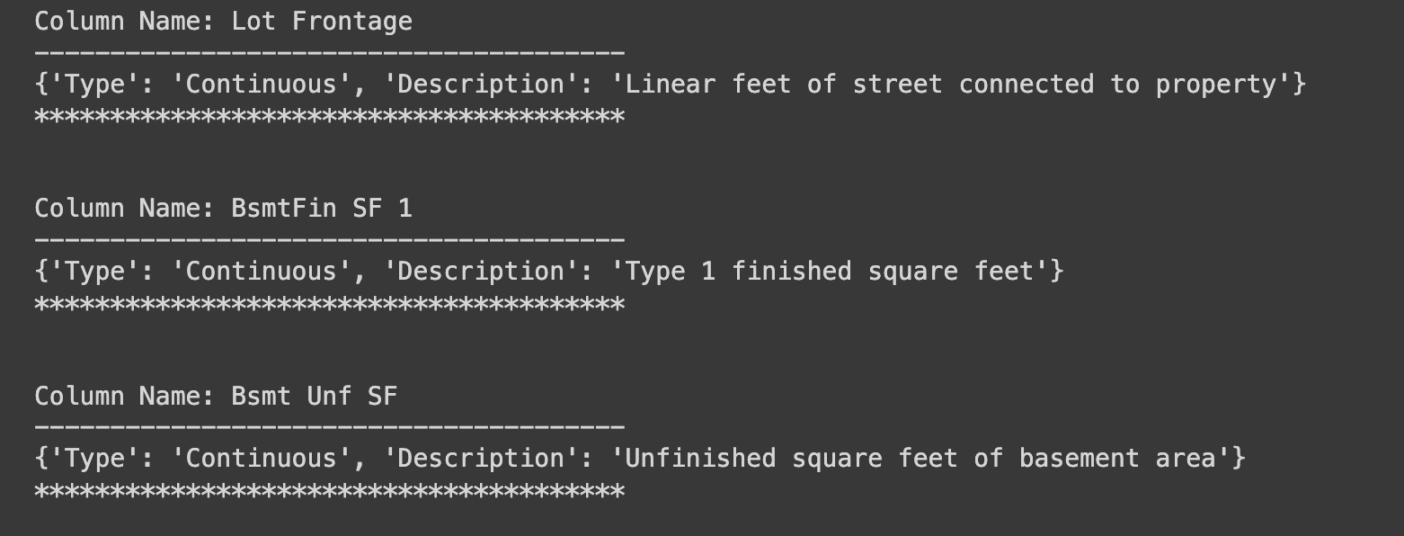
Wrangling
March 27 2024
Notes:
Create one table that has all numerical values. From there I calculate the percentage of Null and Zero and assign a percentage score. Anything over 40 Null or zeros is immediately dropped. This helped me half my numerical features in half. On the right I am showing some code that loops throught the data dictionary. I want to see what the data type is for each value that is in need of imputation. Because your imputation strategy can change depending on the data type this is valuable information.

Slide 6
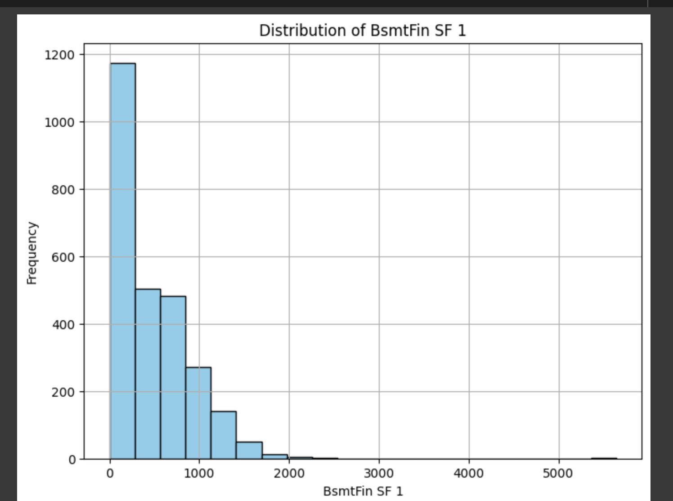
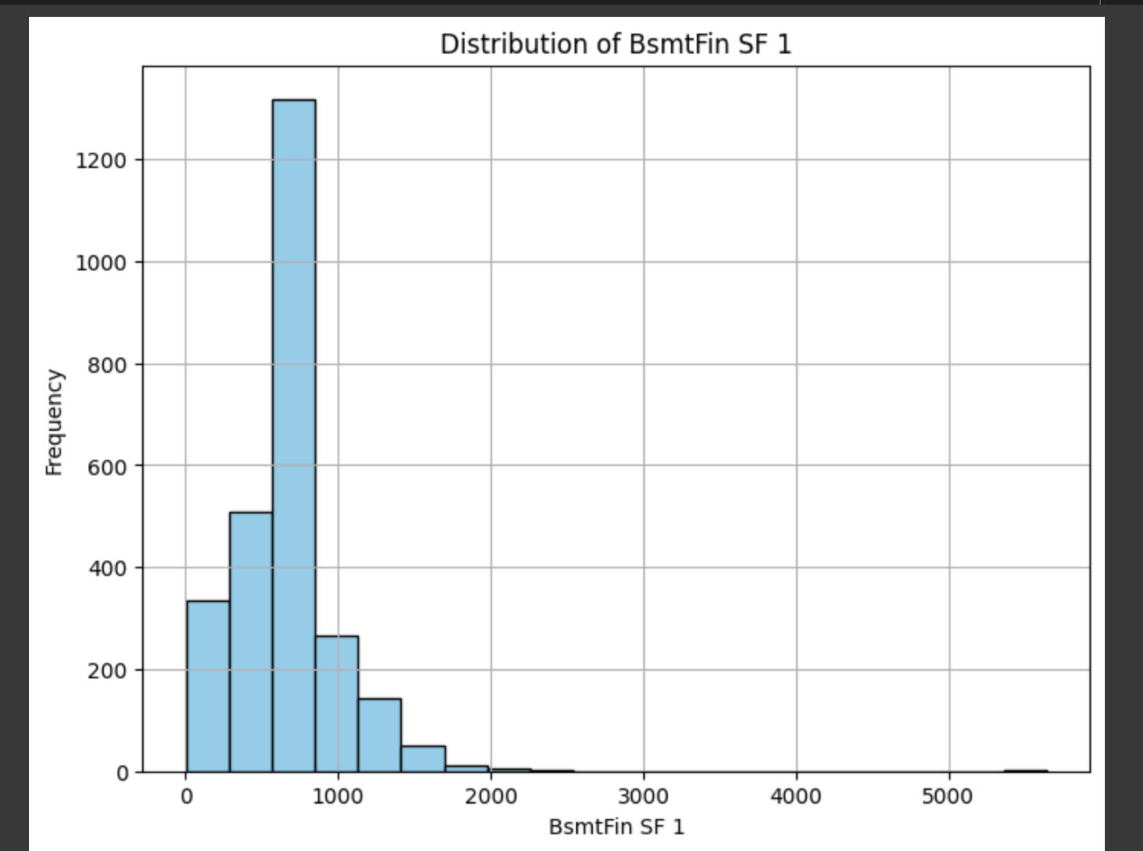
Imputation
March 27 2024
Notes:
Of the features I want to impute I first needed to understand how the data was distributed. This allowed me to further narrow down my imputation strategy. In this example I am imputing the Basement Finished Sq footage. By understanding the distribution I chose to impute based on the median value. This avoids skewing my imputation towards the highest frequency which was zero.

Slide 7
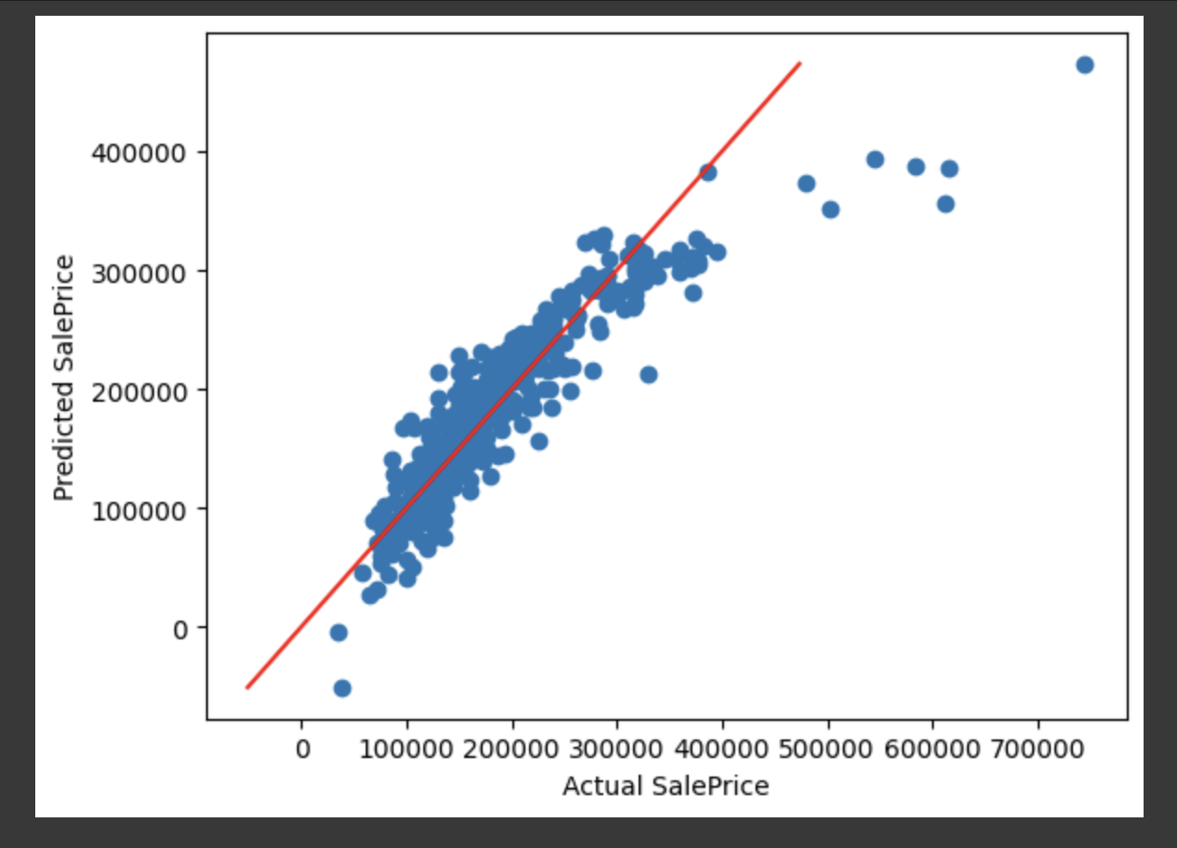
What we did
01
Standard Linear Regression with Robust Scaling
$35,773
RMSE
20%
RMSPE
March 27 2024
Notes:
After testing my first linear regression model I came up with a RSME of 35,773. Meaning I was plus or minus 35K from the actual house price. Or to measure my results a different way my target was on averaged 20% off the actual value.
Looking at my scatter plot Im near the line with some far off prediction in the upper threshold of house prices.
Its a starting point.

Slide 8
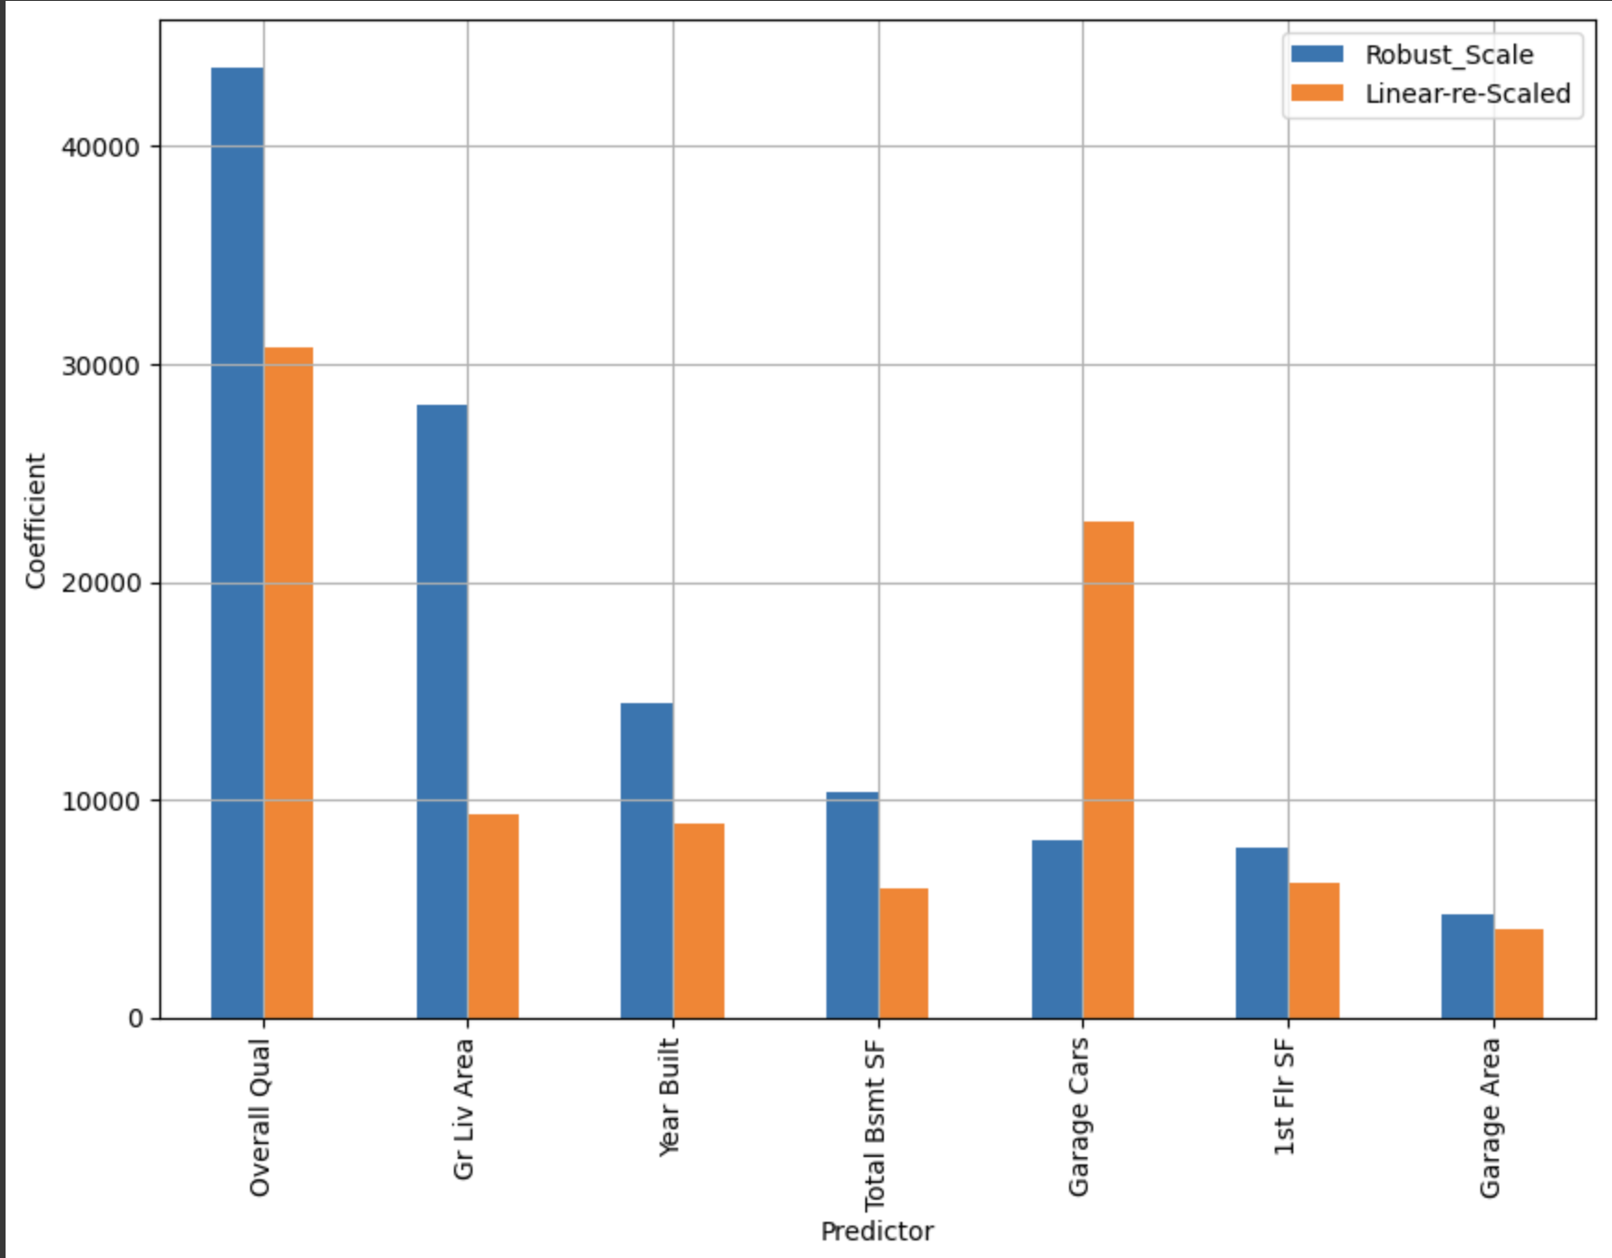
What we did
02
Same as before but Standard Scaling
$35,773
RMSE
20%
RMSPE
March 27 2024
Notes:
Literally the almost exact same prediction as before. I did this to test the impact of the scaling methodology. While it did not have any significant impact on my accuracy it did have some mild impact on the coefficient or the magnitude of relationship between the features and the target.
More interesting to know than anything.

Slide 9
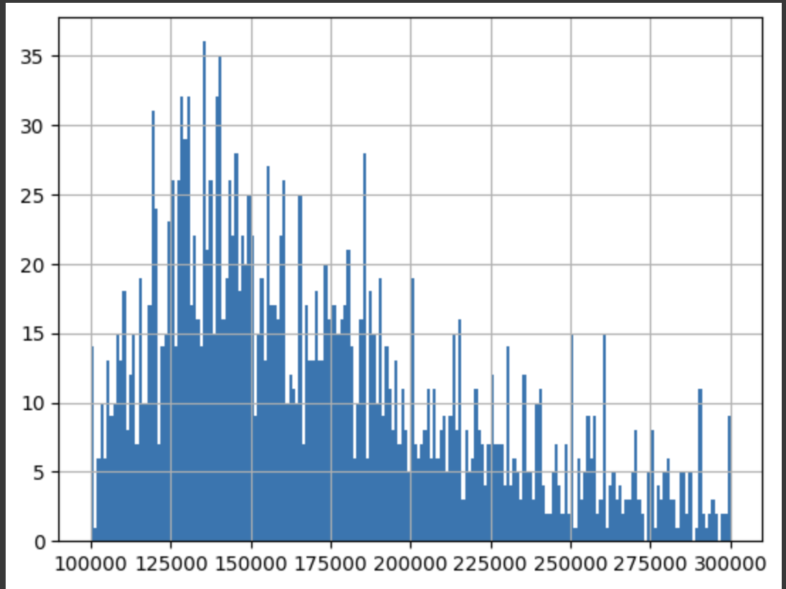
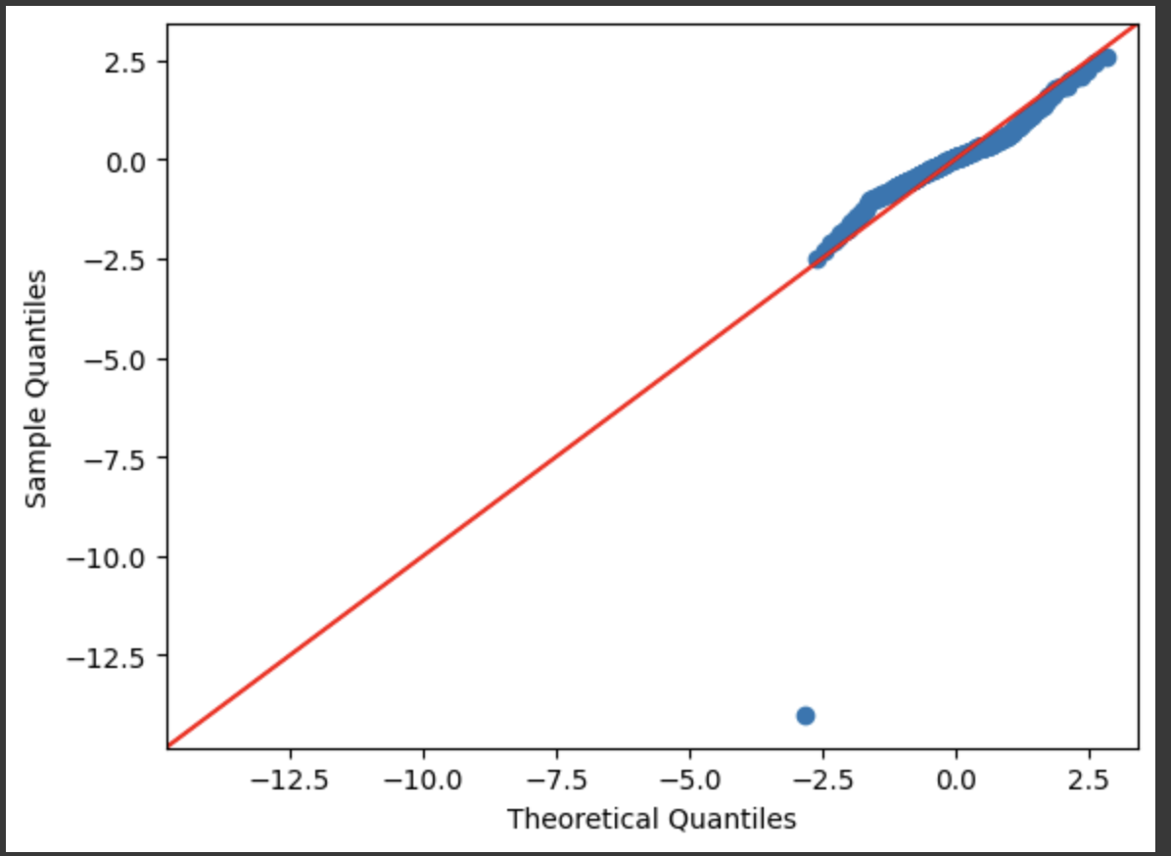
What we did
03
+20%
Ok let’s try something different
$28,983
RMSE
17%
RMSPE
March 27 2024
Notes:
This time around I chose to reduce my target by excluding records above and below a certain threshold. By narrowing the records of both the features and the target I hoped to see some improve of my RMSE/P respectively. Luckily this small data modification increase my accuracy 20 percent. In QQ plotting I see much tighter alignment between the predicted values and the actual observations, as evidenced by the nearly perfect correspondence along the diagonal line.

Slide 10
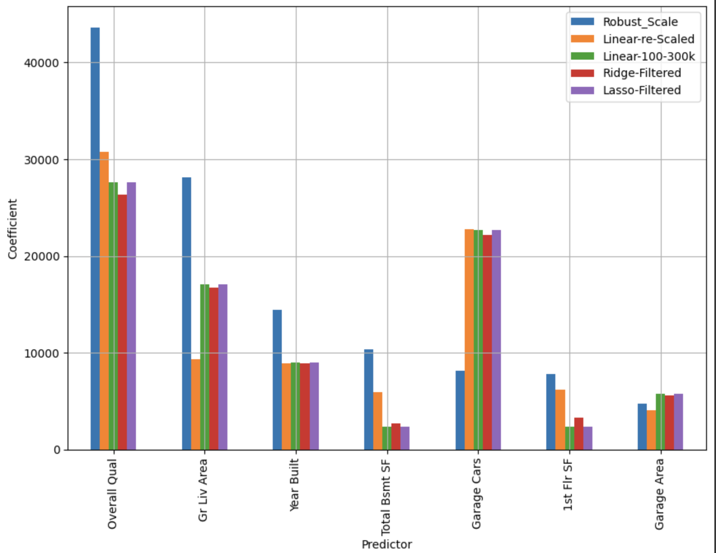
Results
04
+15%
Regulation with Lasso & Ridge Regression
$24K
RMSE
March 27 2024
Notes:
Ridge and lasso regression prevent overfitting and simplify models by shrinking coefficients. Lasso goes a step further by selecting the most important features, leading to robust models that generalize better to new data. For me the increased performance was 15% but I didn't not see a significant change between Ridge or lasso nor did I see any exclusion of features with Lasso.

Slide 11
Next Steps
Next steps
Lesson Learned
Do it all over with Categorical Data
Data Wrangling is King
March 27 2024
Notes:
For my next steps I would next go through the same process with my categorical data. Something I would try out is seeing if it makes any difference to federate my categorical and numerical data into one data set before processing or is there greater fit by having them separated out as their own data set as I did with categorical data.

Slide 12

Summary
Predicted House Prices leveraging Supervised Linear Regression Modeling
Focused on Numerical data
Imputed Nulls and Zeros
No difference between scaling Methodologies
Reference point with RMSE and RMSPE
Regulation with Lasso and Ridge.
Notes:
I went from 81 features down to 7 from beginning to end of my process while increasing my RMSE by 35%.

Slide 13
Thanks
Brannon Dugick Git Hub
Data Source

